Slide 1

Analyzing Song Trends on Spotify
Project by:
Trupal Vijaykumar Chaudhary (200557631)
Ashraf Khan (200512871)
Sushank Saini (200540699)
Amit Malik (200548660)

Slide 2
Objective
The project aims to use the "Spotify Charts" dataset to analyze song trends of singers, identify solutions to improve their popularity, and help them become more competitive in the music industry.
Through exploratory data analysis, the project will provide insights into user preferences and trends, which can help music streaming companies stay up to date with the latest music trends and adapt their offerings to remain competitive.

Slide 3
Dataset: Spotify Charts (3.48 GB)
Source : https://www.kaggle.com/datasets/dhruvildave/spotify-charts
This dataset from Kaggle, contains the top 200 streamed tracks on Spotify every day from Jan 1,
2017, to Dec 31, 2021, collected using the Spotify API. The dataset has 26,173,514 observations
and 9 columns, and it covers countries around the world.

Slide 4
Programming Languages and Cloud Infrastructures
- Python
- PySpark
- Pandas
- Matplotlib
- Seaborn
- Google Compute Engine - Google Colab
- Amazon S3

Slide 5
Data Flow
- Collect 'Spotify Charts' dataset and store it on Amazon S3
- Preprocess and clean using PySpark and Pandas
- Perform exploratory data analysis and generate visualizations
- Generate insights and recommendations
- Store results in Amazon S3 for easy access and sharing

Slide 6
Cost Estimate
Amazon S3:
For 10-15GB of storage, the cost would be approximately $1.50 - $2.25 per month.
Data transfer costs depend on the amount of data accessed and transferred from the S3 bucket. Assuming moderate usage, the data transfer cost would be around $0.05 - $0.10 per month.
Standalone Compute Engine:
Assuming we need 100GB of compute engine with 16/32 RAM, you could use a custom VM with 16 or 32 vCPUs, 100GB of memory, and 1TB of SSD storage.
The estimated cost for this VM would be approximately $800 - $1600 per month, depending on the selected region and the duration of use.
Additional costs may be associated with using PySpark and Google Colab, such as increased memory and storage requirements.
Google Colab Pro costs $9.99/month for 16 GB RAM or $49.99/month for 32 GB RAM.
Overall, the estimated monthly cost of the infrastructure for this project would be around $801.50 - $1602.25, depending on the VM configuration and data transfer requirements.
Notes:
** All prices in USD

Slide 7
Target Audience
The target audience for this business case includes music streaming companies, record labels, and individual singers who want to improve their popularity and competitiveness in the music industry.
Music streaming companies can use the insights gained from this analysis to improve their platform offerings and attract more users.
Record labels can use the analysis to make data-driven decisions about which artists to sign and how to promote their music.
Individual singers can use the analysis to understand the factors that contribute to a song’s success and create music that resonates with their audience.

Slide 8
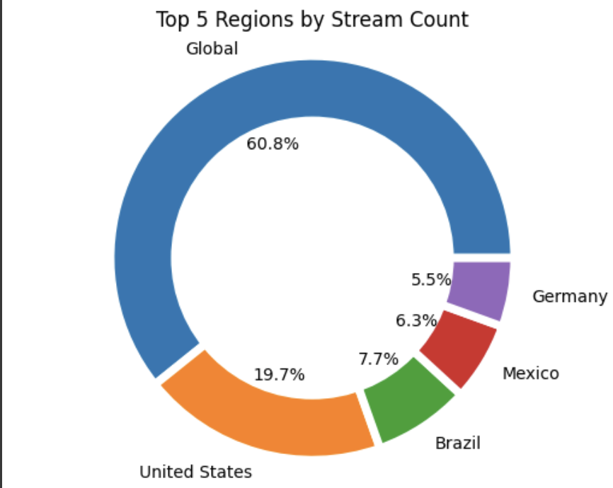
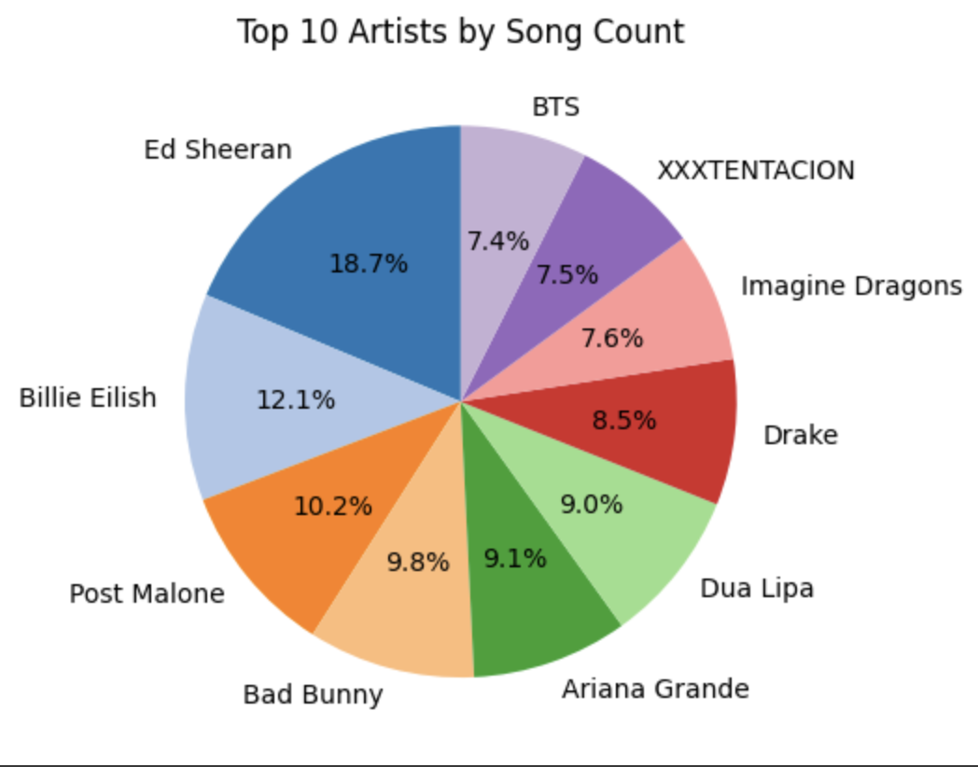
Visualizations and Insights

Slide 9
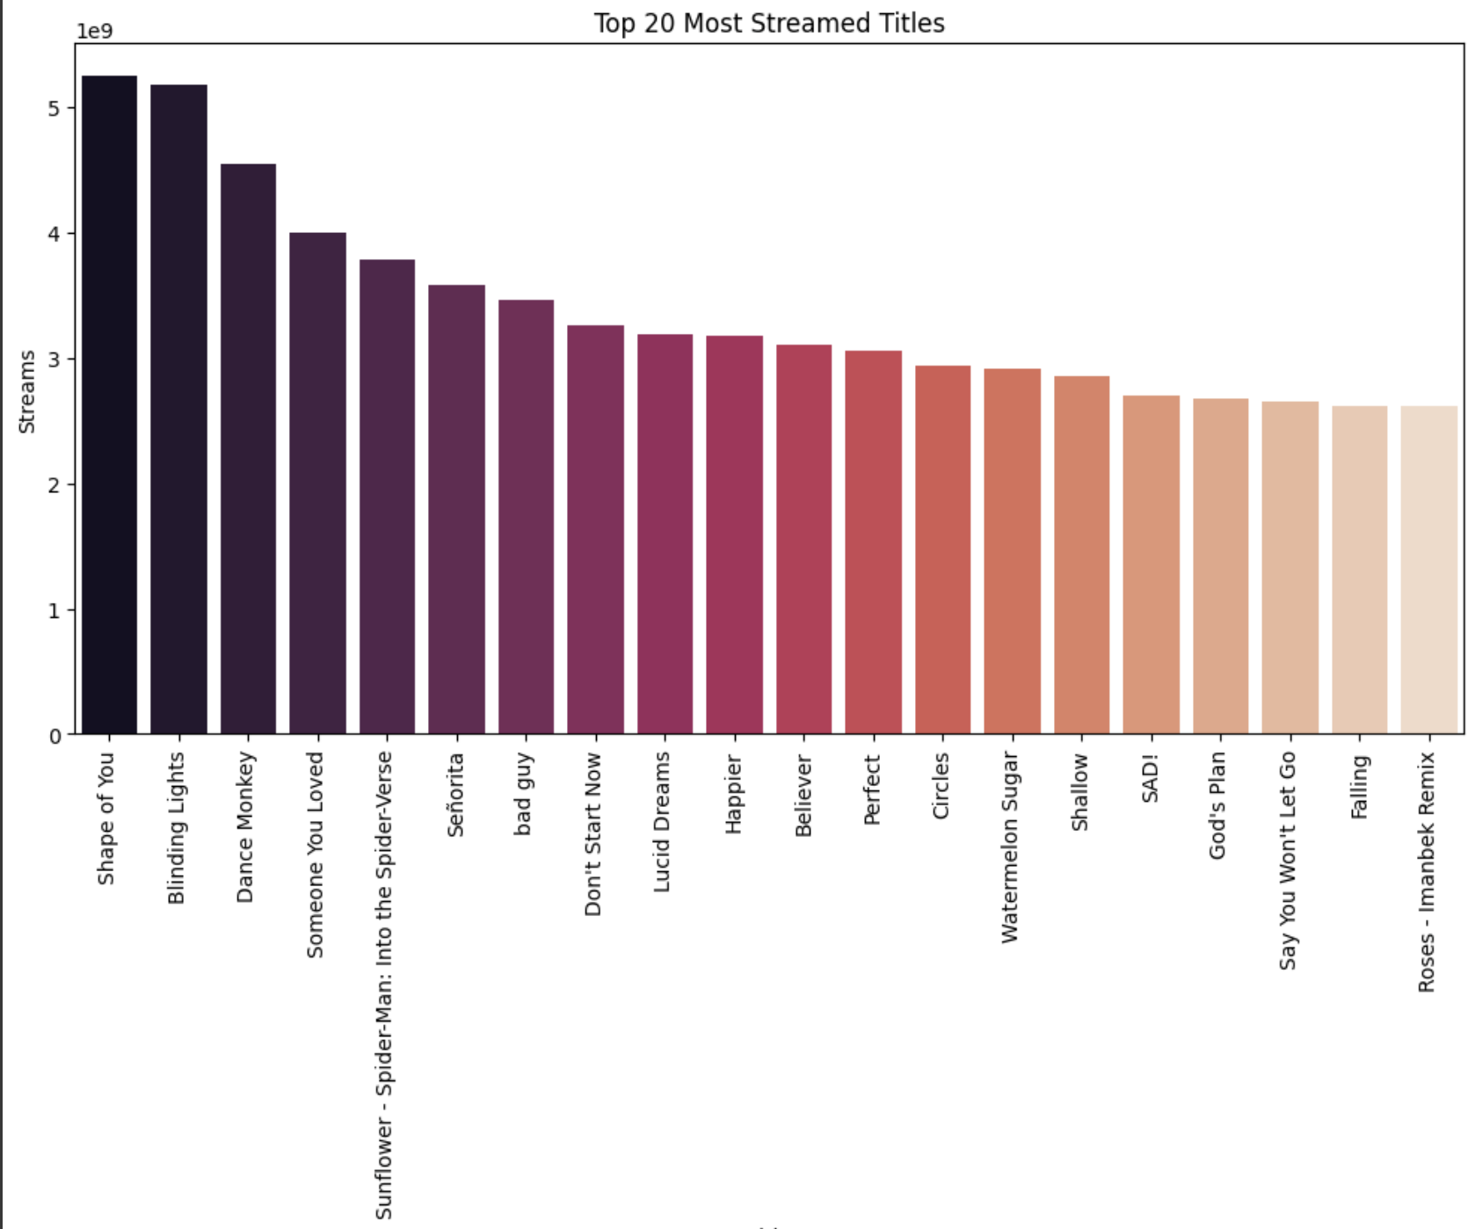
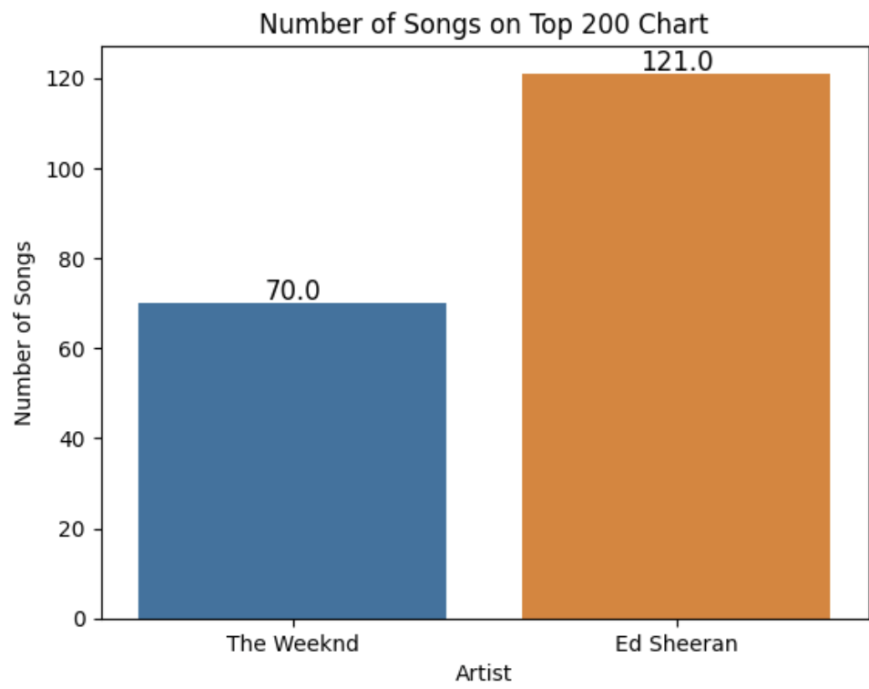

Slide 10
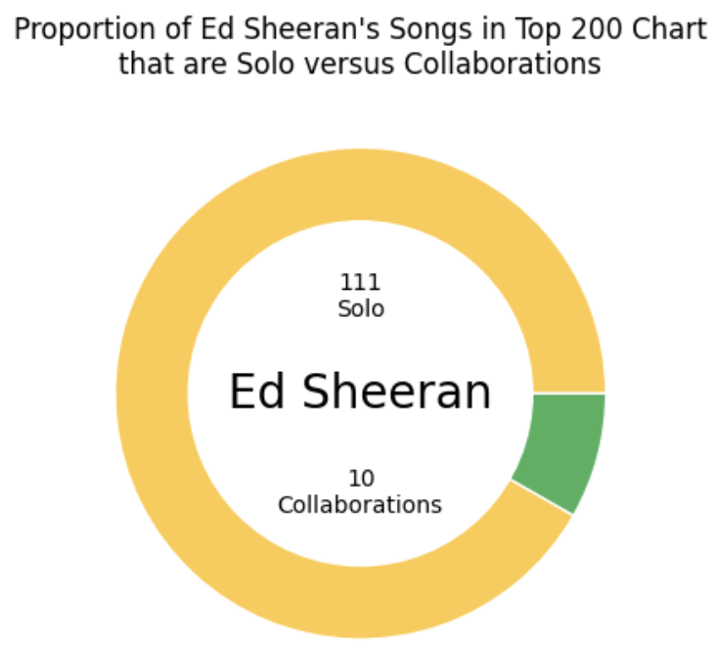
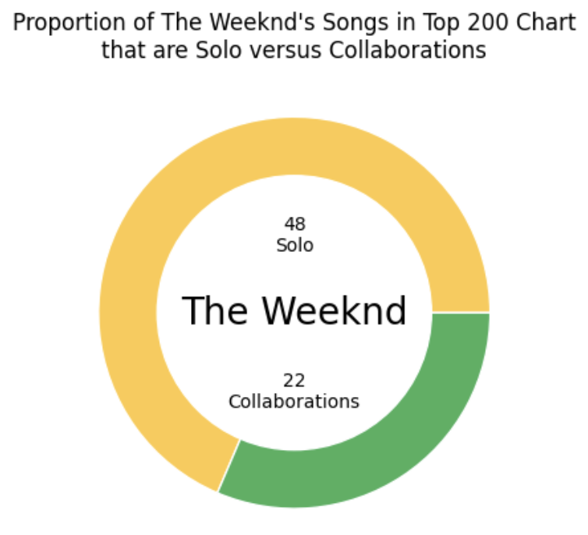
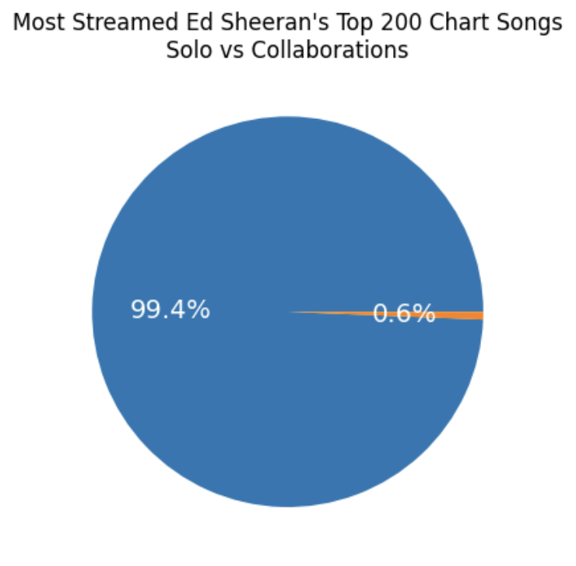
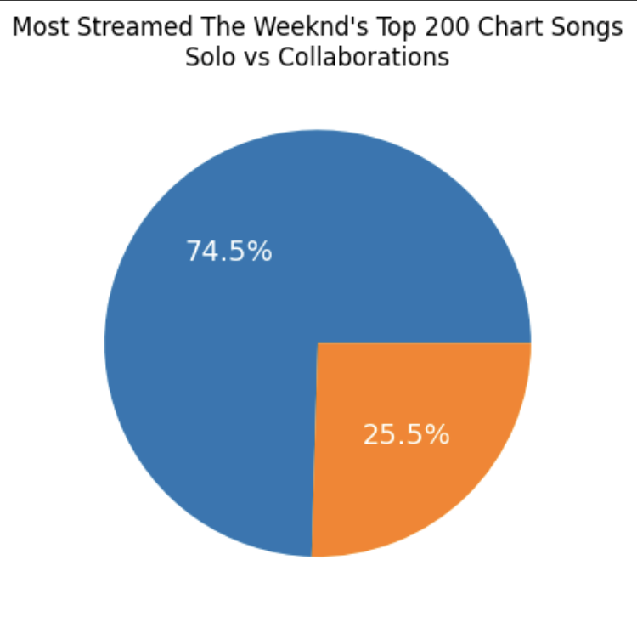
INSIGHT - Ed Sheeran did a smaller number of collaborations and his collab songs were not as successful as solos.
In contrast to that, The Weeknd did more collaborations with other singers and his collab songs had more success than Ed's

Slide 11
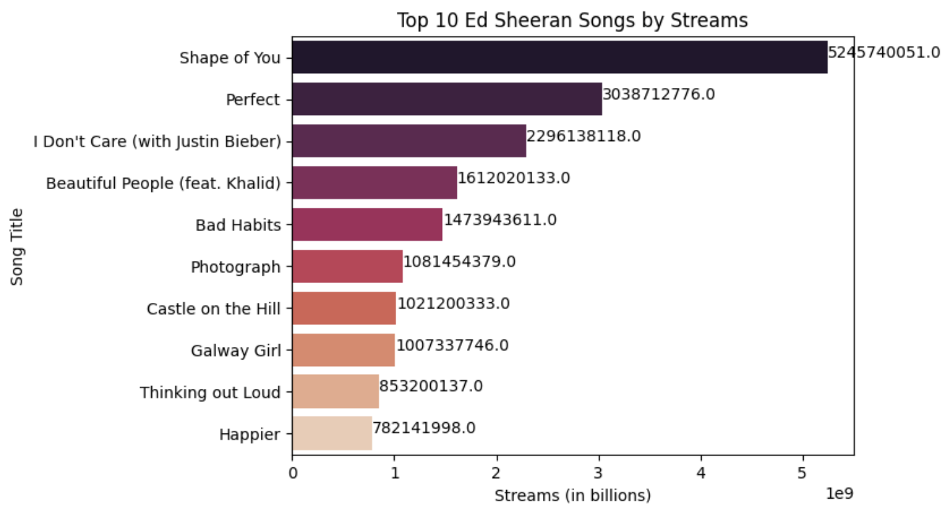
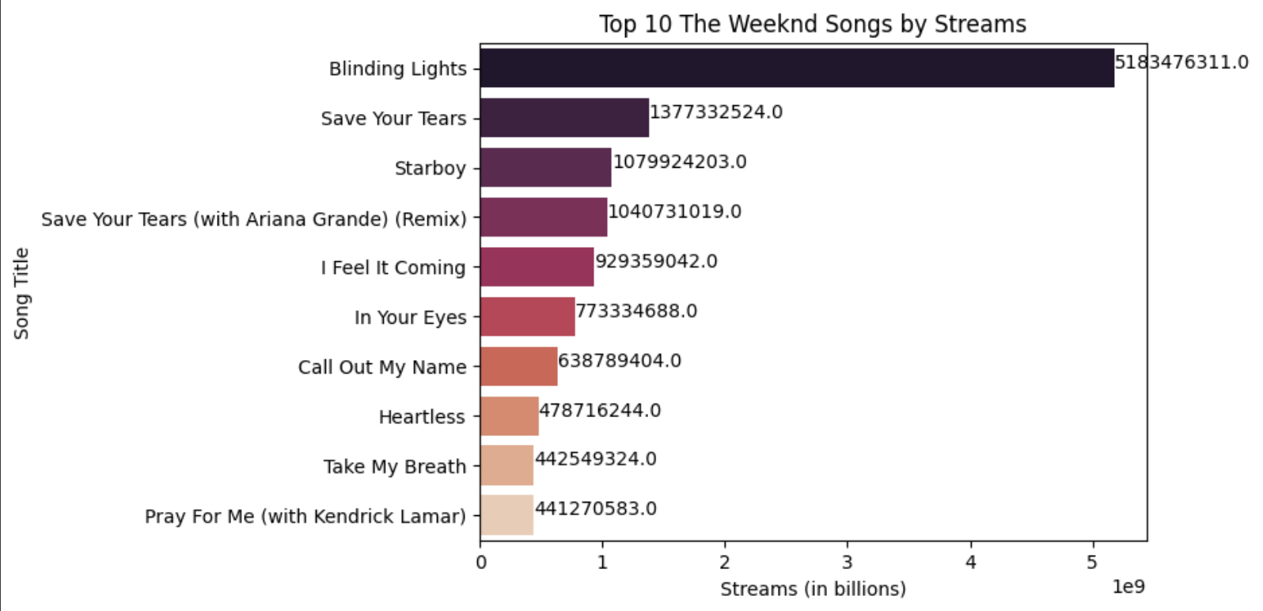

Slide 12
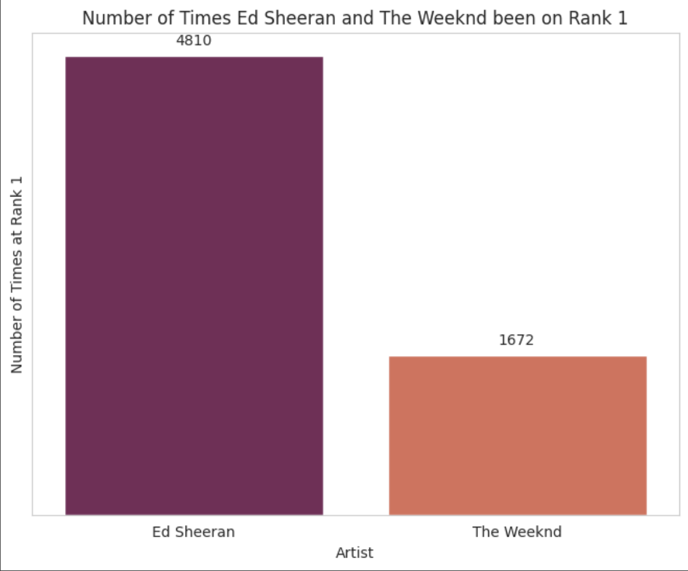

Slide 13
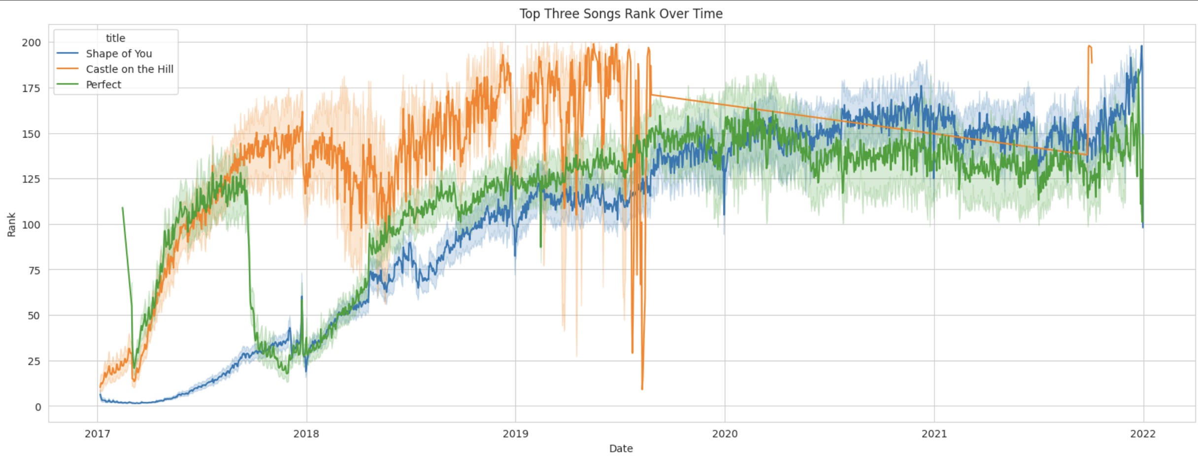

Slide 14
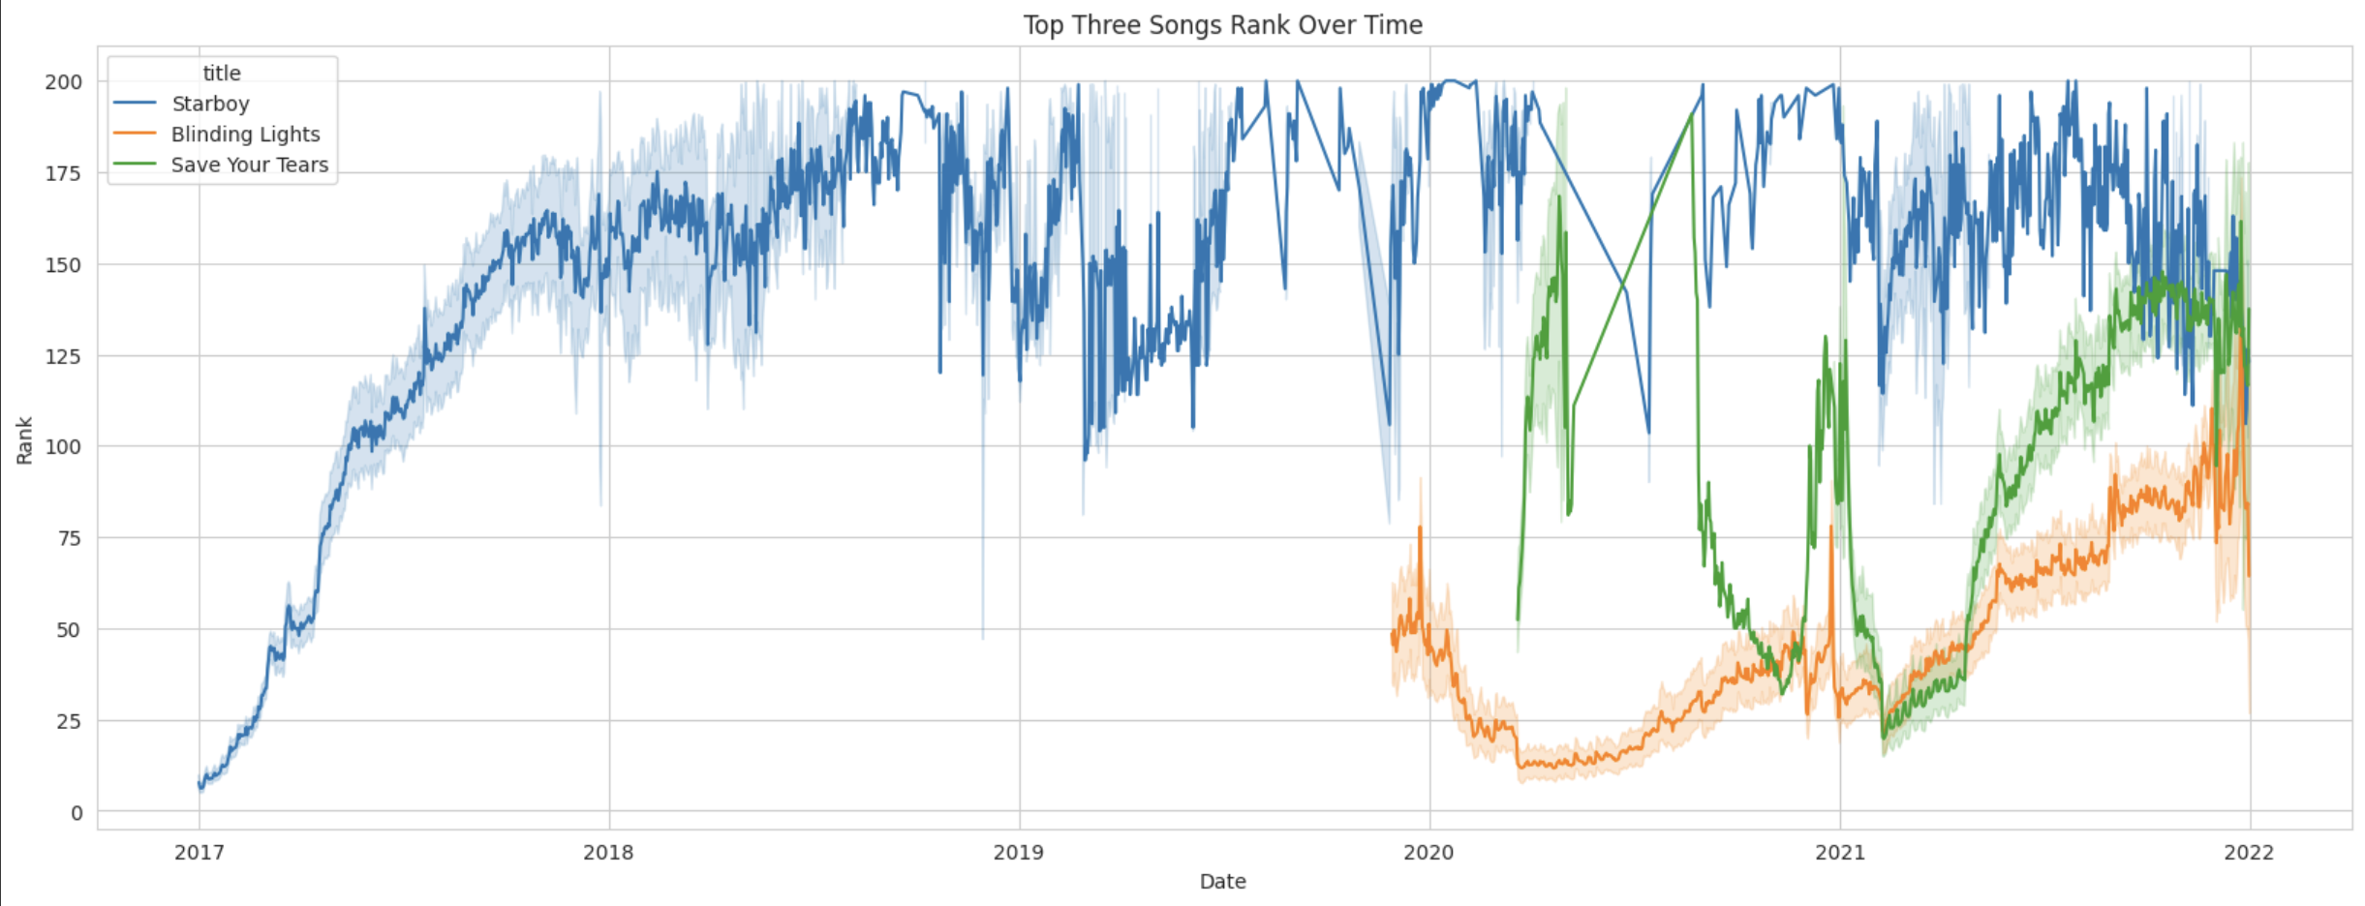

Slide 15
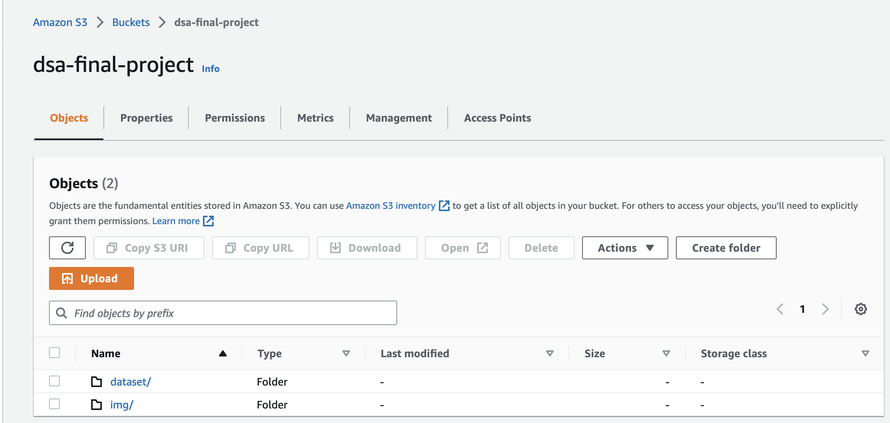

Slide 16
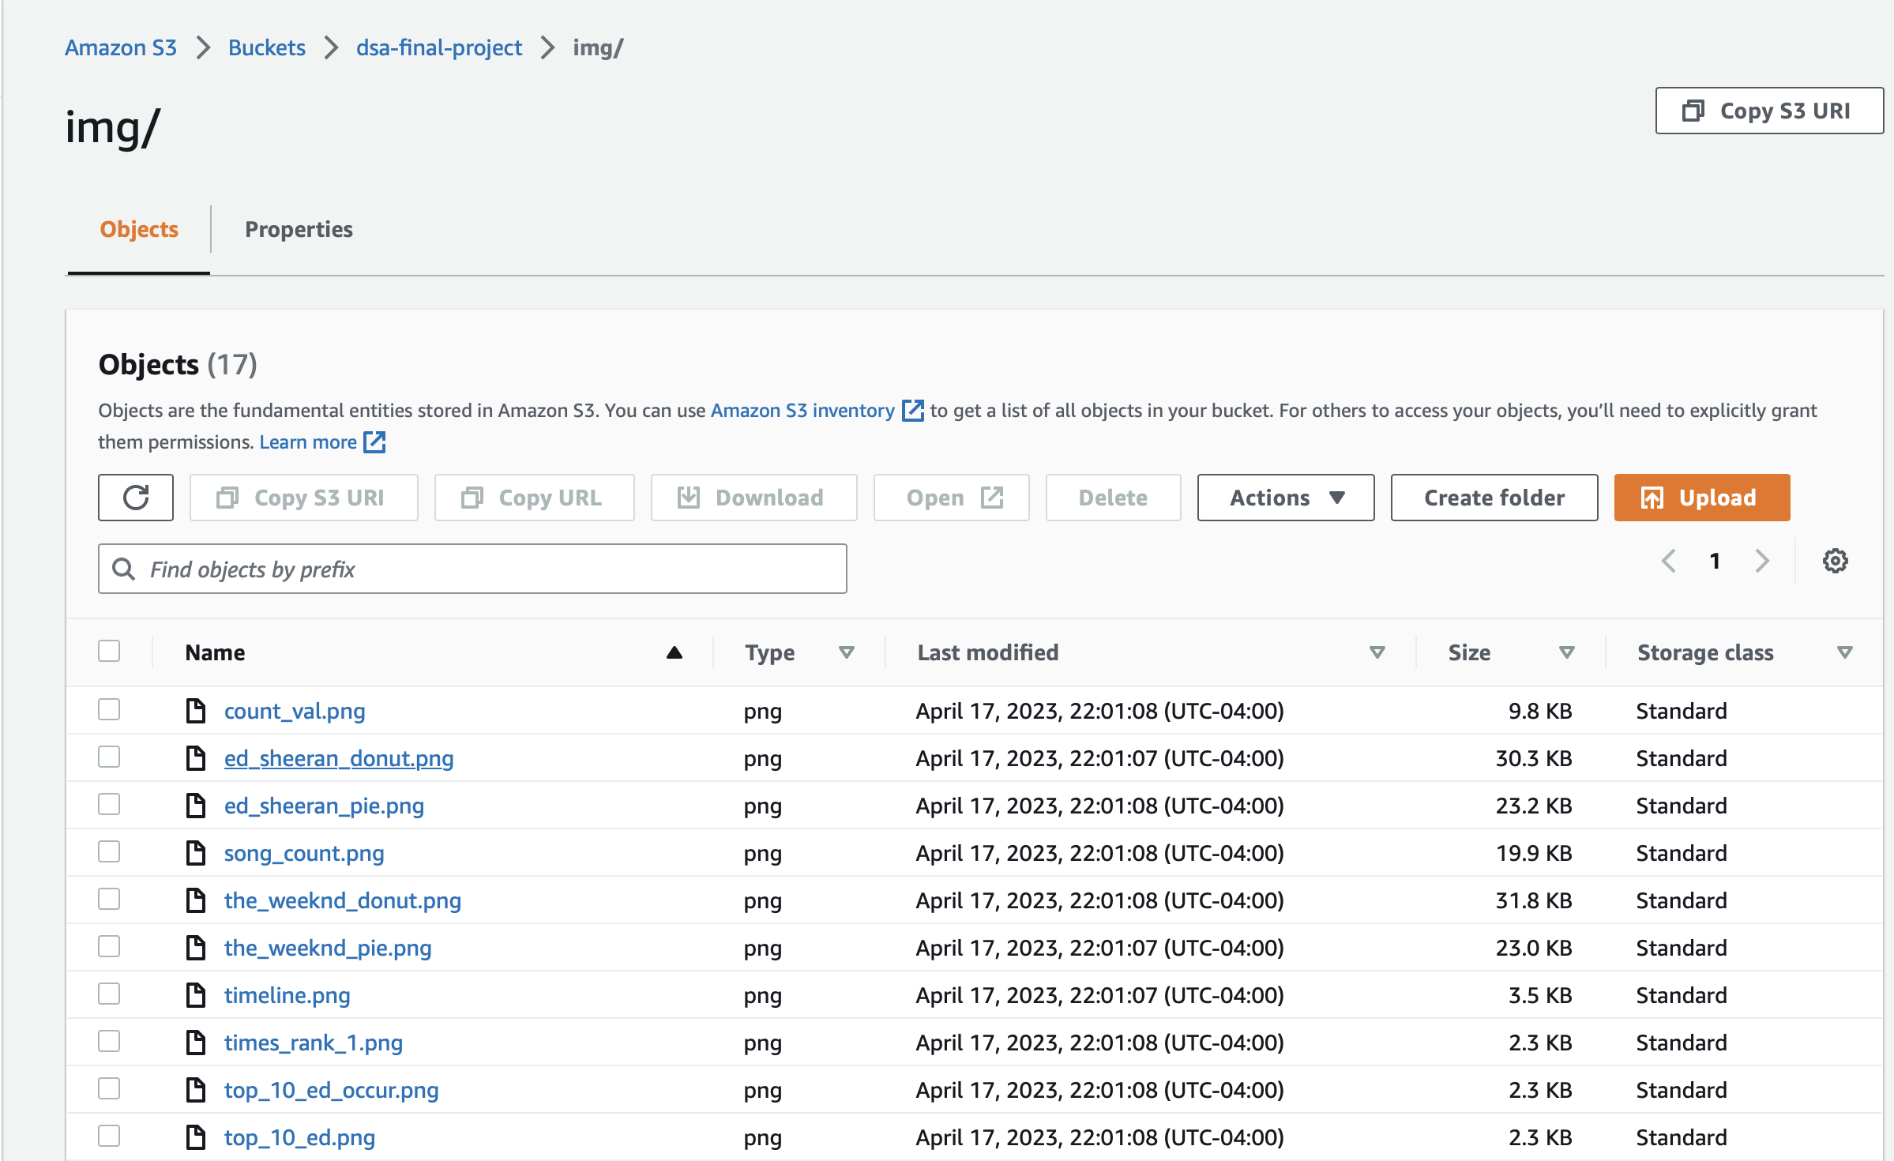

Slide 17
Recommendations
For Ed Sheeran:
1. Leverage his success with solo songs: Since Ed's solo songs have been more popular than his collab songs, he should focus on releasing more solo songs that showcase his unique style and voice. He should also experiment with different genres and styles to keep his music fresh and interesting for his fans.
2. Collaborate wisely: Although Ed's collab songs were not as successful as his solos, he should still consider collaborating with other artists to expand his audience and reach new fans. However, he should be selective in choosing his collaborators to ensure that the songs have the potential for success and align with his brand and style.
3. Maintain global appeal: Ed's music has been well received globally, and he should continue to create music that resonates with a global audience. He should also consider promoting his music on social media platforms, which can help him to reach a younger and broader audience.
4. Leverage his existing success: Ed should leverage his existing success by continuing to perform live shows and concerts. He could also consider collaborating with other artists during these shows to keep things fresh and exciting for his fans.

Slide 18
For The Weeknd:
1. Continue collaborating with other artists: Since The Weeknd's collab songs have been more successful than his solo songs, he should continue to collaborate with other artists. He should also be selective in choosing his collaborators to ensure that the songs have the potential for success and align with his brand and style.
2. Experiment with different genres: The Weeknd has already shown his ability to experiment with different genres, and he should continue to do so to keep his music fresh and interesting for his fans. He should also consider collaborating with artists from different genres to explore new sounds and styles.
3. Focus on promoting his music online: The Weeknd's music has gained popularity after 2020, and he should focus on promoting his music online to continue building his fan base. He should consider partnering with social media influencers to reach new audiences and use data-driven marketing strategies to reach the right people.
4. Leverage his success to perform live shows: The Weeknd should leverage his existing success to perform live shows and concerts. He could also consider collaborating with other artists during these shows to keep things fresh and exciting for his fans.

Slide 19
Conclusion
Overall, this project aims to provide valuable insights into the music industry using EDA. The results can be used by music streaming companies, record labels, and artists to improve their offerings and stay ahead of the competition in this rapidly evolving industry.
We are confident that the insights gained from this analysis will be beneficial to the music industry as a whole and lead to better content and user experiences.

